Slide 1

Lariat Business Analysis
Capstone 1
Michael Sherbin

Slide 2
How Did we do?
Notes:
Here shows the company financials from the macroscale perspective. This is revenue and cost for the year of 2018 from all 50 Lariat locations.
What does this mean?
In reality Lariat rental car company is a fictitious company that made appearances in Veronica Mars, the X-files and Breaking Bad. However this does not stop us from evaluating the data!

Slide 3
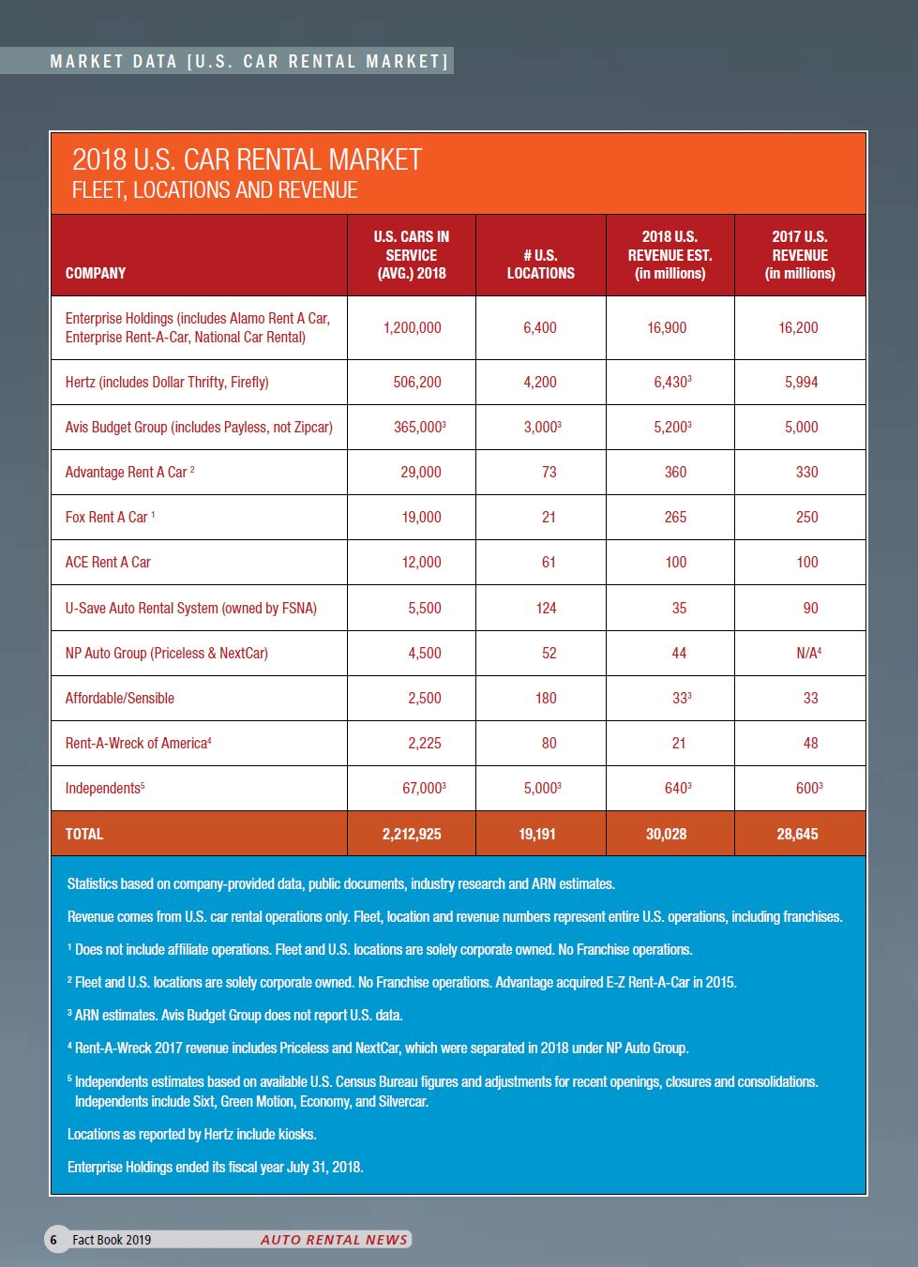
Source: https://www.autorentalnews.com/statistics/download?id=321011
Notes:
In order to give it a reliable comparison I consulted the ever-trustworthy Auto Rental News. Here shows the “top dogs” in the rental car industry in the real world. Now obviously Lariat cannot be compared to the big dogs like Enterprise and Hertz because of the sheer volume of locations would create a high volume of revenue, thus creating an unfair comparison.

Slide 4
https://drive.google.com/file/d/1CdN0nP93BPfKVaybmoiByXAL67KbjzDe/view?usp=sharing
Notes:
The analysis shows that Lariat (if it was a real company) crushed the competition showing that it had more revenue with less locations and cars.

Slide 5
https://drive.google.com/file/d/1CdN0nP93BPfKVaybmoiByXAL67KbjzDe/view?usp=sharing
Notes:
Here is a snapshot of the branch model a link is provided if you are interested in checking it out. This model compares each branch to the minimum average and maximum revenue numbers throughout the company.

Slide 6
Notes:
Here shows the top 5 and bottom 5 branches in terms of Revenue for 2018. The conclusion can be made that there was not a drastic difference in each branches revenue with the range between the highest and lowest revenue only $27,373.

Slide 7
How did the cars do?
How did each car do in 2018?
If we switch from the large-scale perspective and think in terms of types of cars, I believe we can learn a lot about the business and help develop a winning strategy.

Slide 8
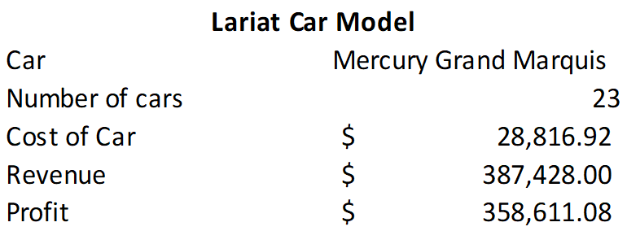
https://drive.google.com/file/d/1CdN0nP93BPfKVaybmoiByXAL67KbjzDe/view?usp=sharing
Notes:
Here is a snapshot of the model created to display each car and relevant information on each car. Feel free to check it out with the link below. This model can shed light on what cars are performing well and what cars are not.
This will help aid in decision making when choosing the right cars for the company moving forward.

Slide 9
Notes:
The range of the most and least profitable vehicle equals over $383,000.
What this means is that this is an area the company can focus on looking into the future.

Slide 10
Thank You For Listening

